Slide 1
EE4007 - OPTICAL ELECTRONICS
January 2010
© Alan P. Morrison
Lecture 3 - Review of Optics and Fundamentals of Lightwave Propagation.
Dielectric Slab Waveguide

Slide 2
FUNDAMENTALS OF LIGHTWAVE PROPAGATION
January 2010
Pulse spreading reduces bandwidth and data capacity of a fibre comms link
  operate at zero dispersion wavelength
  use narrow spectral width sources
  dispersion shifted fibres at minimum attenuation
  use solitons
A soliton is a pulse that travels along a fibre without changing shape
© Alan P. Morrison

Slide 3
FUNDAMENTALS OF LIGHTWAVE PROPAGATION
January 2010
© Alan P. Morrison
Examples of information capacity, based on source
properties and transmission scheme

Slide 4
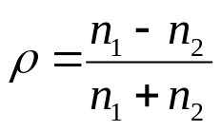
REFLECTION AT A PLANE BOUNDARY
January 2010
Examples:
    air-glass interface where light is coupled into fibre
    interface between fibre core and cladding
    the two air-glass boundaries in any air-gap between two connected fibres
Simplest computation for reflection loss => incident beam normal to boundary
Reflection co-efficient (normal incidence):
Negative reflection co-efficient => 180⁰ phase shift between incident and reflected electric fields
© Alan P. Morrison
Ratio of reflected to transmitted electric field

Slide 5
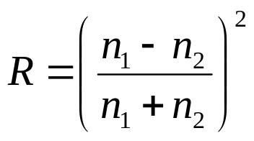
REFLECTION AT A PLANE BOUNDARY
January 2010
Reflectance:
For non-normal incidence, the fraction of light reflected depends on the angle of incidence and the polarization of the electric field relative to the plane of incidence
© Alan P. Morrison

Slide 6
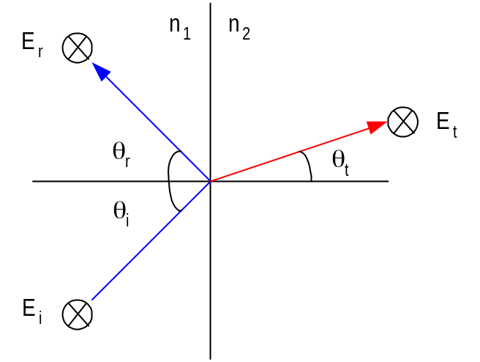
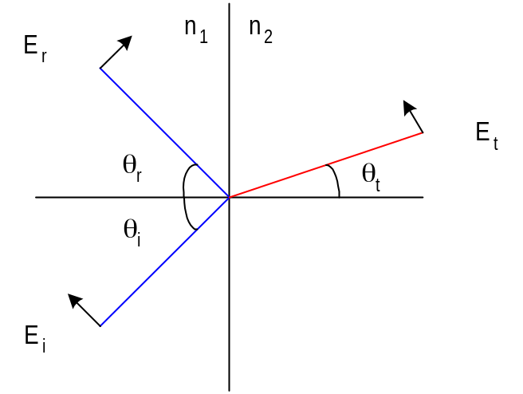
REFLECTION AT A PLANE BOUNDARY
January 2010
s-polarization: electric field polarized perpendicular to plane of incidence
p-polarization: electric field polarized parallel to plane of incidence
© Alan P. Morrison

Slide 7
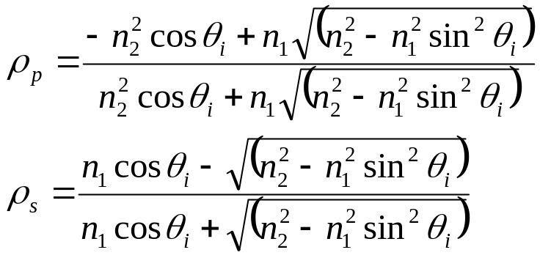
REFLECTION AT A PLANE BOUNDARY
Fresnel’s laws of reflection
Reflectance found by squaring magnitudes of reflection coefficients – (Do as exercise in Mathematica)
Some features:
    reflectance does not vary much for incident angles near zero
    zero reflectance for p-polarisation at angle: θ_{Β} , called Brewster Angle, where tan θ_{B} = n₂/n₁
    total reflection for angles greater than critical angle:
    sin θ_{C} = n₂/n₁
January 2010
P-polarisation
S-polarisation
© Alan P. Morrison

Slide 8
DIELECTRIC SLAB WAVEGUIDE
January 2010
Diagram of dielectric slab waveguide: (see next slide)
Light waves trapped in middle dielectric by total internal reflection
For total reflection, the boundaries must be smooth and n₁ > n₂, n₃
For efficient transmission, the material absorption must be small (LiNbO₃ (1dB/cm) and GaAs (2 dB/cm)for example)
symmetrical structure (n₂=n₃) is interesting because it closely resembles optical fibre
© Alan P. Morrison

Slide 9
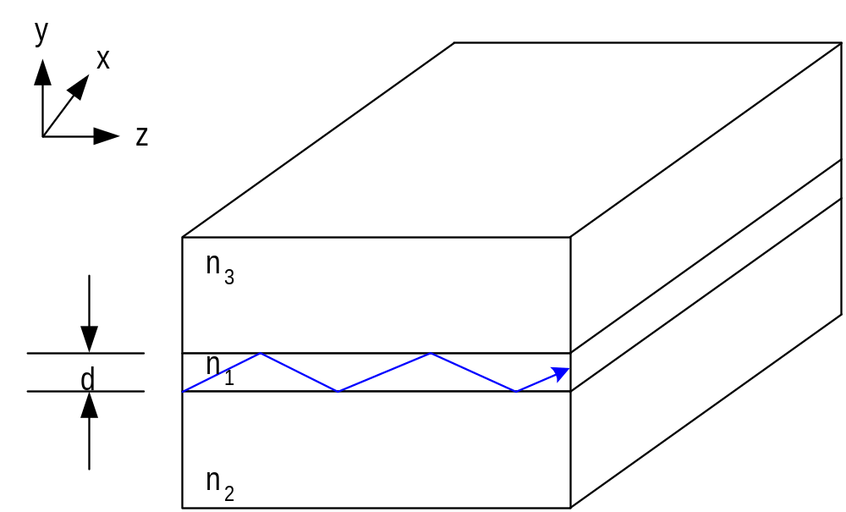
DIELECTRIC SLAB WAVEGUIDE
January 2010
© Alan P. Morrison

Slide 10
DIELECTRIC SLAB WAVEGUIDE
January 2010
Asymmetrical waveguide, having n₃=1.0 is also important
Effective refractive index: n_{eff}=n₁sin θ , this is the free-space velocity divided by the guided velocity.
In a symmetric waveguide, there will be guided propagation (total internal reflection) for all angles greater than the critical angle and up to 90º.
For rays at 90º, the effective index is n₁
For rays at the critical angle, the effective index is n₂
© Alan P. Morrison

Slide 11
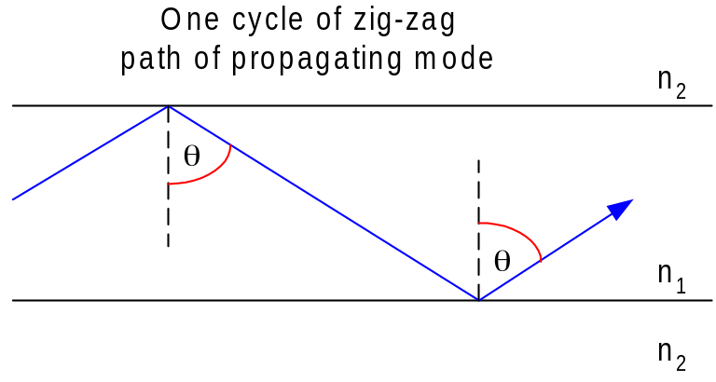
DIELECTRIC SLAB WAVEGUIDE
Mode condition: Δφ = m2π
    all waves having ray directions between critical angle and 90^{O} will be trapped in the film by total internal reflection
    not all of these waves will propagate along the structure as only certain ray directions are allowed
    allowed directions correspond to modes of the waveguide
    modes are stable interference patterns in the waveguide, occurring only when the phase shift for one cycle of the zig-zag path of a propagating ray equals an integral no. of 2π radians
January 2010
© Alan P. Morrison

Slide 12
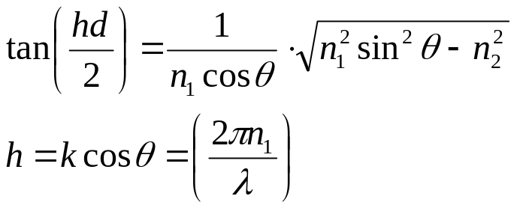
DIELECTRIC SLAB WAVEGUIDE
January 2010
TE and TM polarization
    TE corresponds to s-polarization
    TM corresponds to p-polarization
TE Mode chart:
    For even TE modes, solution is:
    For odd modes, (hd/2) is replaced by (hd/2)-(π/2)
    d is the waveguide thickness
© Alan P. Morrison

Slide 13
DIELECTRIC SLAB WAVEGUIDE
January 2010
For a known film thickness it is difficult to determine the ray angle directly from the preceding equation
    simpler to choose various angles between the critical angle and 90º and solve for the corresponding thickness
    A plot of the results gives relationship between thickness and propagation angle
Example:
    symmetrical slab, n₁=3.6, n₂=3.55 (characteristic of AlGaAs DH laser)
    critical angle is 80.4º
© Alan P. Morrison

Slide 14
DIELECTRIC SLAB WAVEGUIDE
January 2010
    Range of angles for trapped rays is 80.4º<= θ <= 90º
    refractive index range is: 3.55 <= n_{eff} <= 3.6
    see Table for calculations
θ (deg)
n_{eff}
tan(hd/2)
hd (rads)
2πn₁cosθ
d/λ
80.4
3.55
0
0
3.757
0
82
3.565
0.651
1.155
3.148
© Alan P. Morrison
0.367
84
3.580
1.235
1.780
2.364
0.753
86
3.591
2.161
2.275
1.578
1.442
88
3.598
4.653
2.718
0.789
3.445
90
3.600
∞
3.142
0
∞

Slide 15
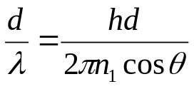
DIELECTRIC SLAB WAVEGUIDE
January 2010
    Compute (d/λ) using:
    if free space wavelength is known we can find d
    Results of calculations are plotted on a mode chart and labelled as TE₀
Higher order modes
    Because mode solution is a tangent function => repeats itself and has multiple solutions
    For any given propagation angle, there is a set of film thicknesses that will allow rays in that direction
    Previous solution (TE₀) yields the smallest value of normalised thickness
© Alan P. Morrison

Slide 16
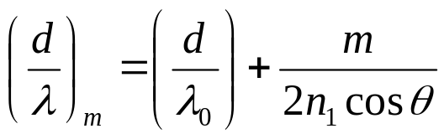
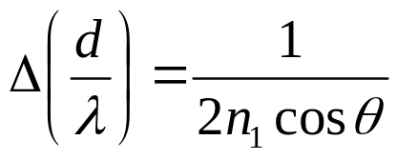
DIELECTRIC SLAB WAVEGUIDE
January 2010
    Denote first solution as (d/λ)₀, other solutions (both even and odd modes) are:
    where m is a positive integer. Each value of m corresponds to a different allowed mode of the waveguide
    normalised thickness is incremented by an amount:
    Table shows calculation of first 6 TE modes
© Alan P. Morrison

Slide 17
DIELECTRIC SLAB WAVEGUIDE
January 2010
θ
[deg]
n_{eff}
TE₀
(d/λ)₀
Δ(d/λ)
TE₁
(d/λ)₁
TE₂
(d/λ)₂
TE₃
(d/λ)₃
TE₄
(d/λ)₄
TE₅
(d/λ)₅
80.4
3.550
0
0.836
0.836
1.672
2.508
3.344
4.18
82
3.565
0.367
0.998
1.365
2.363
3.360
4.358
5.356
84
3.580
0.753
1.329
2.082
3.410
4.739
6.068
7.397
© Alan P. Morrison
86
3.591
1.442
1.991
3.433
5.424
7.415
9.406
11.40
88
3.598
3.445
3.980
7.425
11.40
15.38
19.36
23.34
90
3.600
∞
∞
∞
∞
∞
∞
∞

